Slide 1
Comp Plan Update: Single Member Districts ANC 5B03 and 5B05

Slide 2
The Comprehensive Plan
2004
2006
Notes:
The Comp Plan is required as part of the Home Rule act and has two components—The federal component that the National Capital Planning Commission develops. The District Elements in which OP develops and which help guide policies across the District.
By law it requires the Comp Plan to connect to the 5 year Capital Improvement Plan (CIP) of our budget; as well as zoning which can not be inconsistent with the Comp Plan.
The Comp plan is not zoning. Zoning is under the purview of the independent Zoning Commission.
The Comp Plan was written in 2006 and amended in 2011. Given how our city has changed in that time, it is important that we amend it now to reflect today’s conditions, opportunities, and challenges – including housing, equity, resilience and public resources.
The Comp Plan is a high-level guiding document that sets a positive, long-term vision for the District, through the lens of its physical growth and change. It allows us to be intentional about how and where we change, and how we balance competing interests in order to ensure a vibrant, equitable, and resilient city, not only for us, but for our children and grandchildren.
It establishes a vision and broad goals to help inform decision-making and provide context for residents, officials, and stakeholders and can help guide and inform more fine-grained planning efforts.

Slide 3
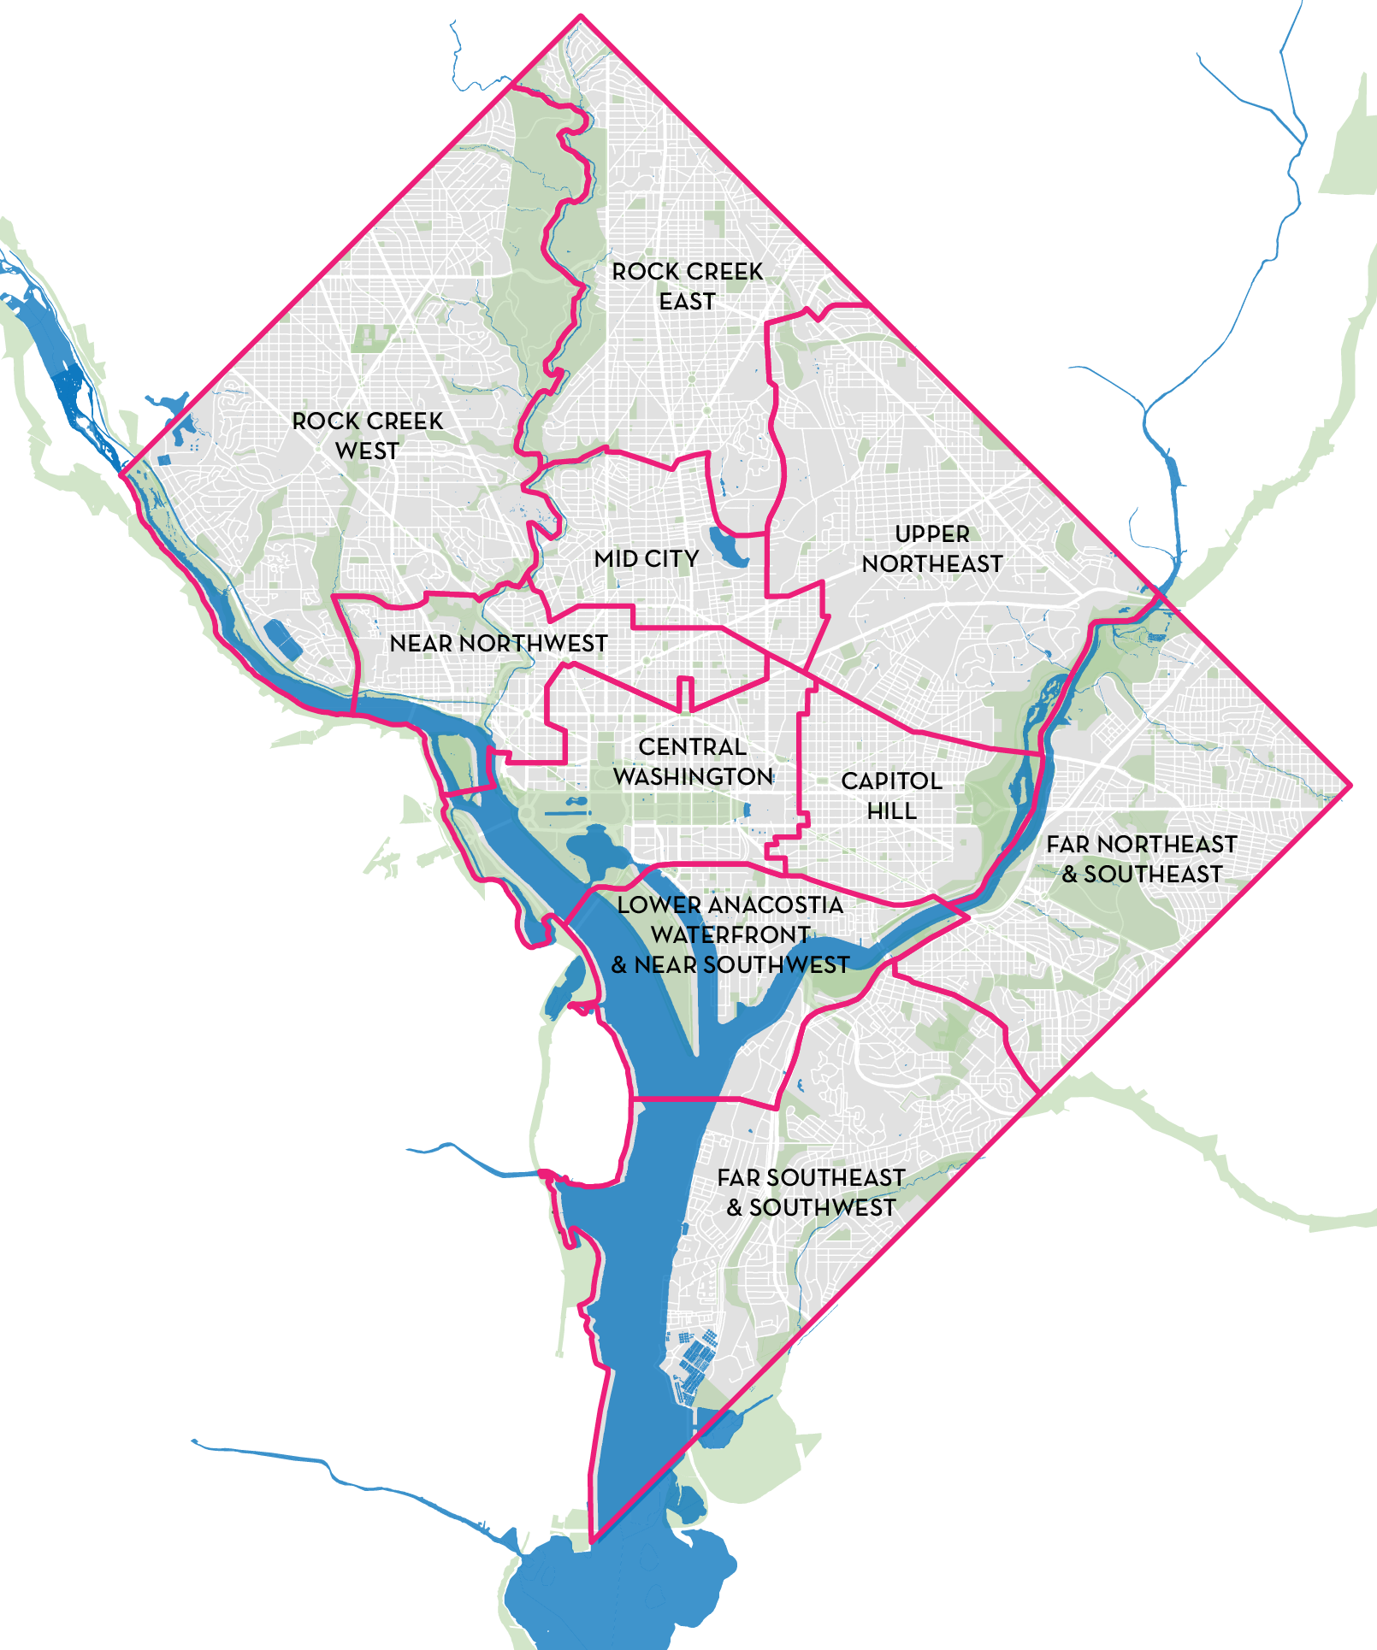
Comprehensive Plan Elements
Context Elements
Area Elements
Framework
Introduction
Implementation
Citywide Elements
Land Use
Economic
Development
Housing
Arts &
Culture
Environmental
Protection
Transportation
Community Services & Facilities
Education Facilities
Urban Design
Historic
Preservation
Infrastructure
Parks, Recreation & Open Space
Notes:
There are 25 elements or chapters in the Comp Plan. As you may know, the first element, the Framework was introduced to Council in January of 2019. It had its first reading in July and approved by Council on October 8.
The Framework is the foundational element of the Comp Plan and through analysis of data and forces driving change, sets the context for the rest of the plan. Council approval of the Framework on 10/8 was a critical component for OP to move forward in the amendment process. It has also helped surface the major concerns and issues that residents and Councilmembers would like the Comp Plan to address.
As you can see here, the remaining elements are divided into citywide elements, like housing, arts and culture and transportation and 10 area elements.
While planning areas are similar to Wards, we do not use Wards because they change every 10 years with Census. Planning areas also allow us the opportunity to group similar neighborhoods together.

Slide 4
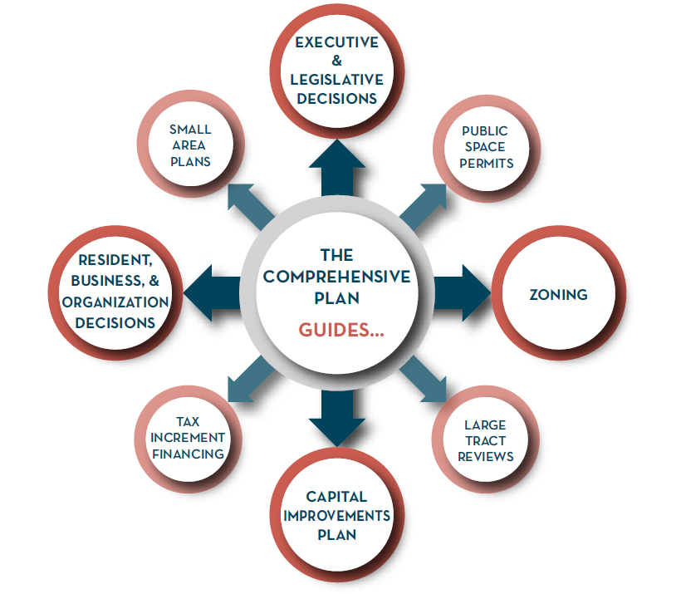
Comprehensive Plan Supports Numerous Decisions

Slide 5
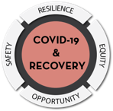
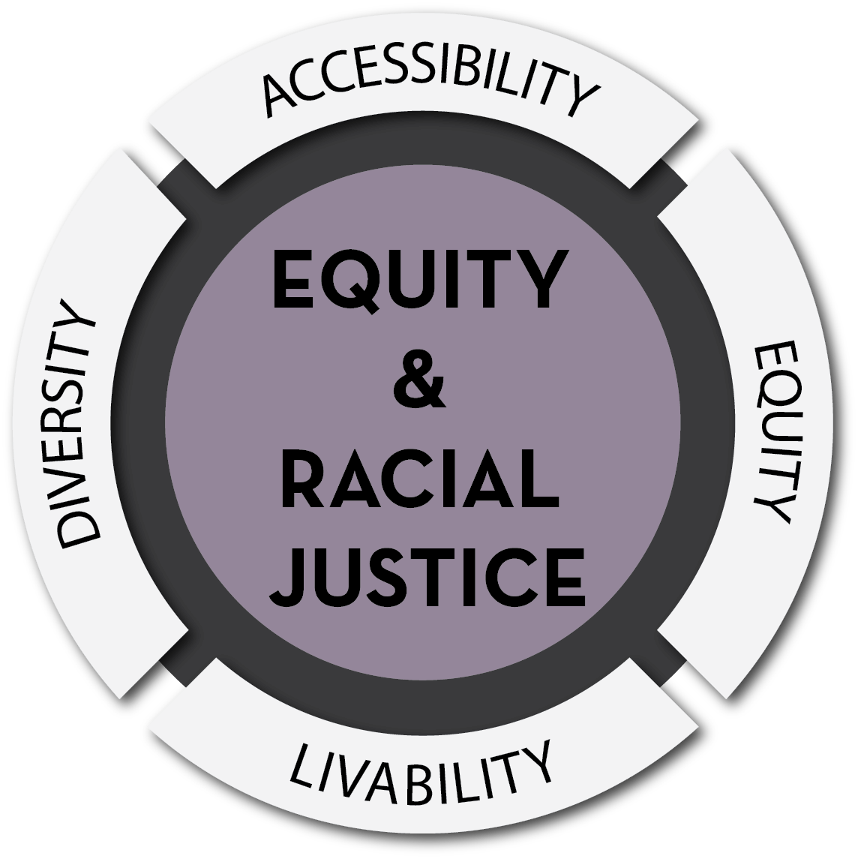
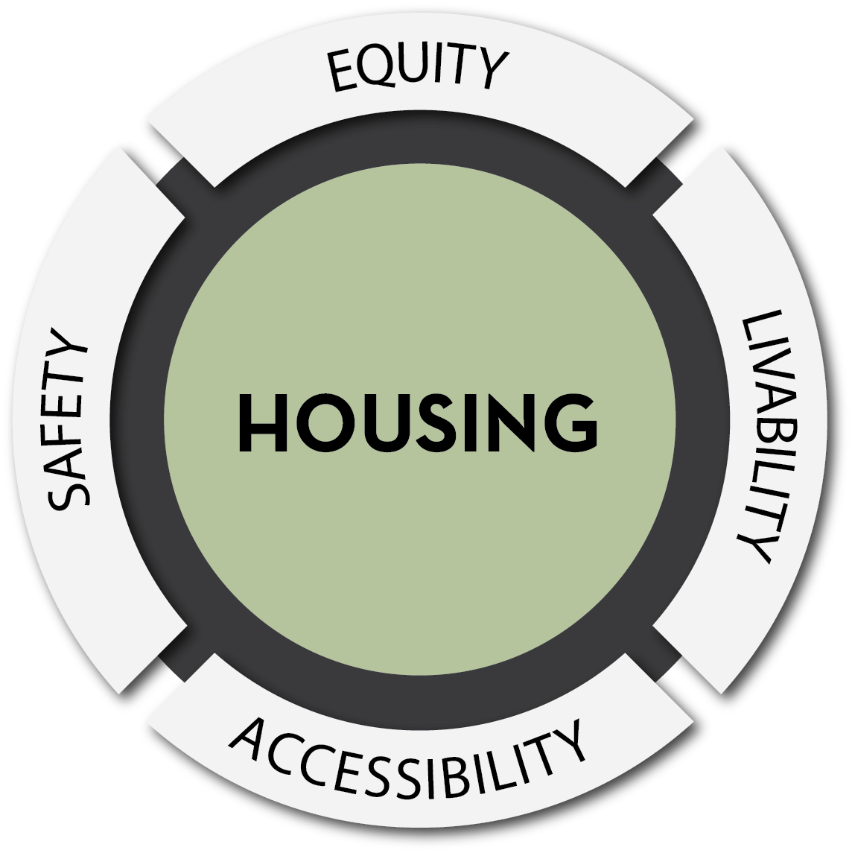
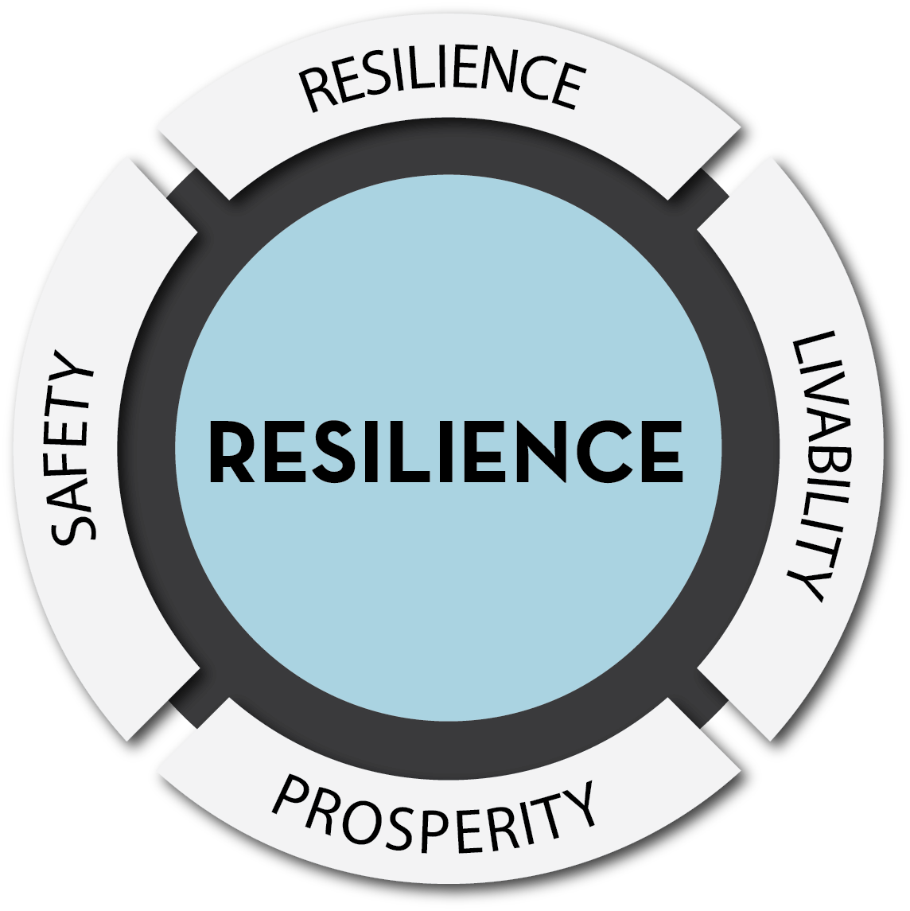
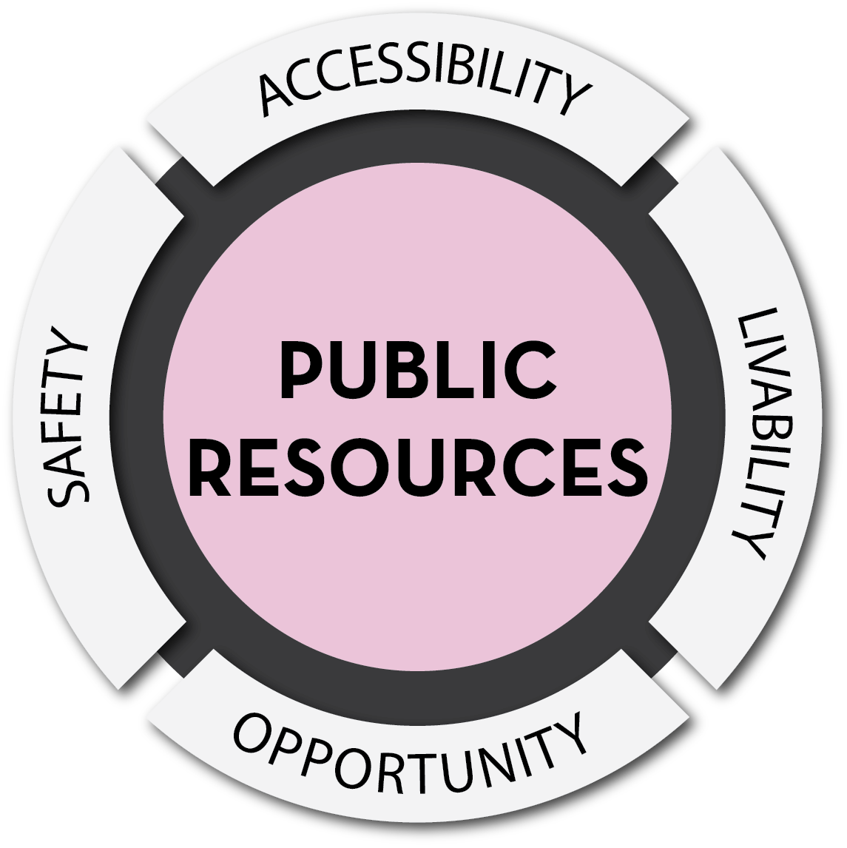
Comprehensive Plan Update Major Themes
COVID-19 and Recovery: Guides COVID-19 response and recovery including through economic monitoring, housing needs, resilience efforts, a broadened frame for emergency planning.
Equity and Racial Justice: Highlights, through a crosswalk, nearly 100 polices and actions that will help ensure all residents have what they need to thrive, no matter their race, age, neighborhood or income. These policies are supported by important data and trends throughout the update that reflect current disparities.
Housing: Presents policies and actions that support the District’s goal of producing 36,000 new units by 2025 and to address pressing issues across the housing continuum, including housing affordability, physical, economic and cultural displacement, and housing for specific populations.
Resilience: Introduces approaches to help respond to both human-made and natural shocks and stressors, including displacement and other risks posed by climate change and public health emergencies.
Public Resources: Introduces coordination between master facilities plans across parks, schools, libraries, and rec centers and acknowledges the importance of public spaces for cultural life and celebration.

Slide 6
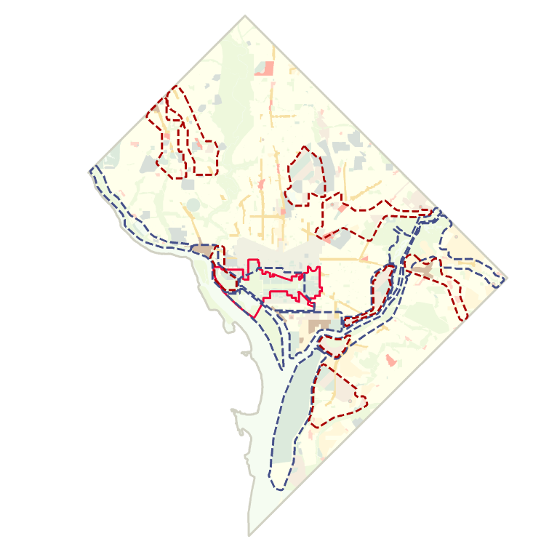
Generalized Policy Map
Upper
Connecticut
Avenue
Upper Wisconsin Avenue
North Capitol Crossroads
General Policy Map: guides land use decision-making in conjunction with the Future Land Use Map and Comp Plan text.
Key policy areas include:
Future Planning Analysis Areas
Resilience Focus Areas
Proposed State of Washington, Douglass Commonwealth (red)
New York Avenue NE Corridor
C&O Canal
National Arboretum/ Kingman Island
Georgetown
Federal Triangle
Kenilworth Park/
Watts Branch
Foggy Bottom/
West End
RFK
Stadium
Potomac Park
Benning Road
Southwest
Waterfront
Anacostia Park
Poplar Point
Joint Base
Anacostia- Bolling
Congress
Heights

Slide 7
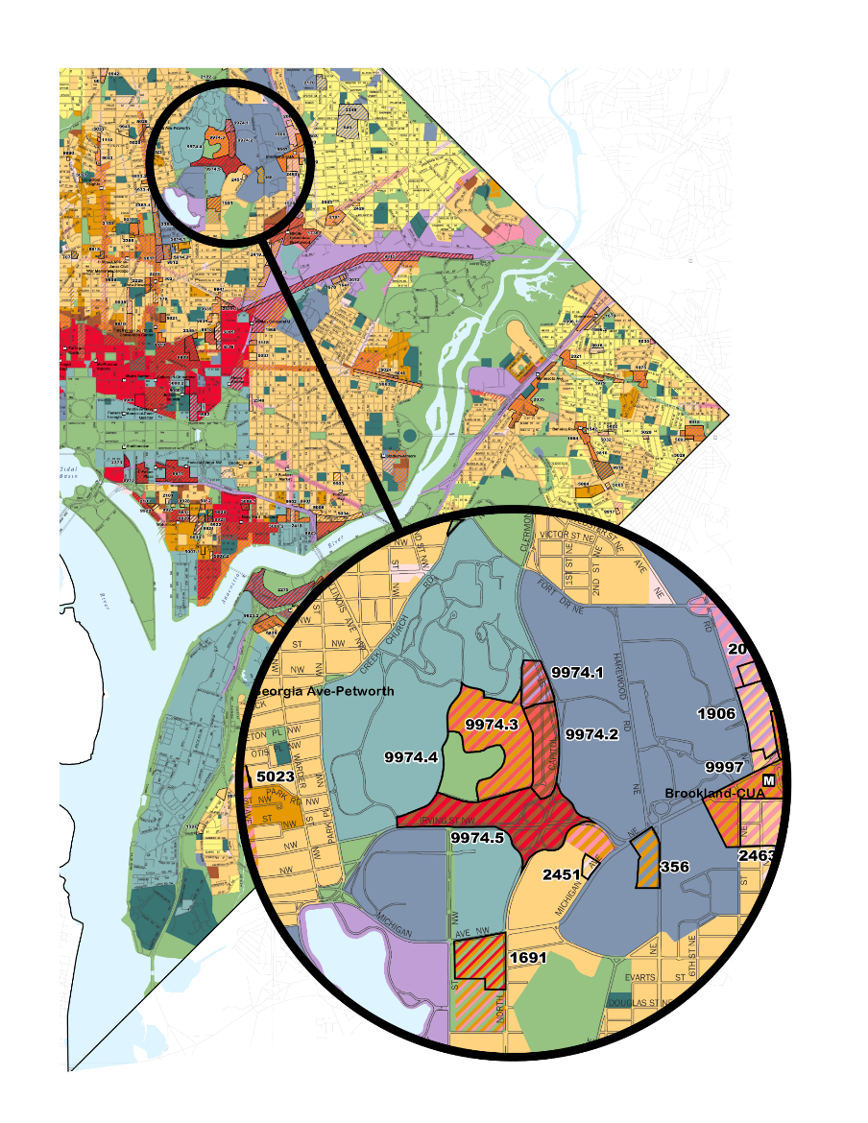
Future Land Use Map
Land Use Element: Effectively balances the competing land use demands to support neighborhood, District, and regional goals. Provides opportunities for additional housing and employment opportunities.
Key policy areas include:
Supporting Growth
Improving resilience and equity
Balancing competing demands
Providing housing, particularly affordable housing
Notes:
The FLUM is divided into land use categories, from low to high and across commercial, residential, and industrial. It is of interest to anyone who wants to build anything in the District as zoning must be in alignment with it. Please note: the FLUM is not a Zoning Map.

Slide 8
ANC Feedback
ANCs from all Wards expressed interest in prioritizing safe, accessible, and activated open space
OP updated language about parks and open space.
ANCs also prioritized the need for housing options to meet the needs of all residents.
This feedback helped shaped new policies, actions, and expanded language across all elements to consider the housing needs of older adults, the LGBTQ+ community, people with disabilities, and other vulnerable populations

Slide 9
Public Review – Feedback Consideration
Did the feedback align with the 40 principles of the Comprehensive Plan?
Was the feedback addressed sufficiently in another element?
Was the feedback appropriate to incorporate into a high-level land use guidance and decision-making document?
Reminder: The Comp Plan does not dictate zoning, create laws or programs, make budgeting decisions, or plan for operations of government.
Was there sufficient analysis and community engagement of the feedback to incorporate it?

Slide 10
Public Review – Feedback Integration
OP analyzed 1,000+ public comments and approximately 1,500 comments from 34 ANCs across all eight wards
78% of the feedback was integrated, supported, or acknowledged in the Mayor’s proposal
16% of the comments were incorporated as proposed, or with some modifications
62% of the comments were already captured in one or more parts of the Comprehensive Plan
The updated FLUM (10/15/19 Public Review → Mayor’s Draft) created an additional 2.3% of land use capacity on less than 1% of land area (535 acres)

Slide 11
Comprehensive Plan Timeline
Visit: chairmanmendelson.com/cow/compplan/ for Comp Plan updates
Notes:
Public engagement has been a hallmark of the Comprehensive Plan update process and has been broader and deeper outreach of any previous effort for an update. Through various engagement events and venues, OP has heard from tens of thousands of residents and stakeholders. This input has helped shape the update. In 2016, OP kicked off the amendment cycle by hosting seven town hall meetings across the District. Then, in 2017, during the official open call for amendments, OP held over 100 community-based office hours across all eight wards. The open call process yielded over 3,000 amendment proposals. OP also incorporated public input from other venues, including feedback provided through the DC Council’s review of the Framework Element in 2018 and 2019; OP's 2019 DC Values Campaign, which reached nearly 3,100 residents and stakeholders across all eight wards; and numerous housing engagements in 2019. The update integrates more than 40 plans produced by District agencies, including small area plans, the preparation of which entailed hundreds of public engagements. In October 2019, OP launched the final public review process, and took several steps to prioritize meaningful ANC participation, including holding trainings about the process and timeline; hosting ANC-specific trainings about key changes; and attending ANC meetings. As a result, OP received 33 official ANC resolutions.

Slide 12
Thank You
For More Information Contact:
Evelyn Kasongo, Lead Planner, Wards 1 & 5
DC Office of Planning
Evelyn.Kasongo@dc.gov
planning.dc.gov

