Slide 1
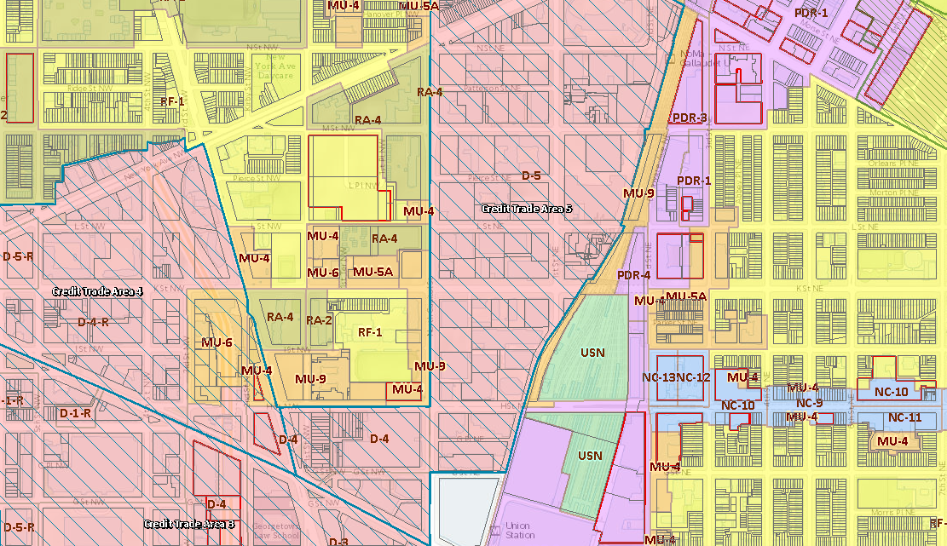
ZONING 101 for ANC 5B
D.C. Office of Zoning
May 2021

Slide 2
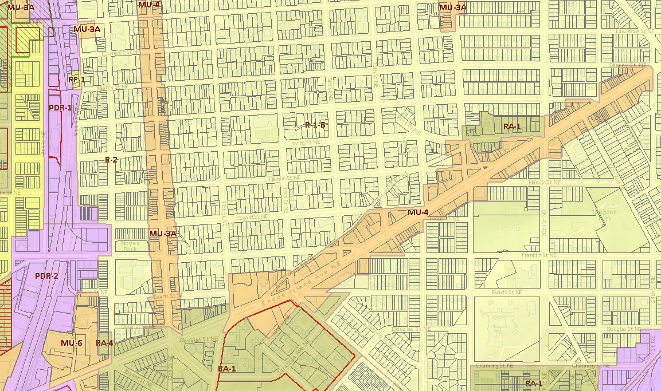
General Overview of the Zoning Process

Slide 3
WHAT IS ZONING?
Zoning is the process of dividing land into zones to regulate:
Uses that are allowed, conditionally allowed, or prohibited
The bulk, size, and placement of buildings
Zoning actions implement the long-term goals set in the Comprehensive Plan

Slide 4
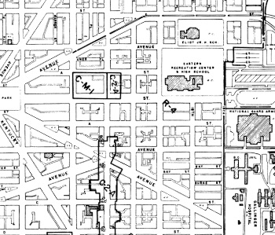
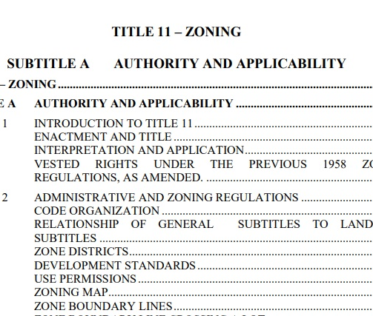
WHAT IS ZONING?
Zones are shown on the Official Zoning Map on the Office of Zoning website
Requirements of the zones are reflected in the Zoning Regulations (Title 11 DCMR)

Slide 5
PARTICIPANTS IN THE ZONING PROCESS
Zoning Commission (ZC): Adopts and amends the Zoning Regulations and Zoning Map; also hears contested cases, such as Planned Unit Developments (PUDs) and Design Review
Board of Zoning Adjustment (BZA): Hears cases related requests for zoning relief and appeals of administrative decisions related to zoning
DC Office of Zoning (DCOZ): Provides professional, technical, and administrative assistance to the ZC and the BZA in support of their oversight and adjudication of zoning matters in the District

Slide 6
PARTICIPANTS IN THE ZONING PROCESS
Office of Planning
Propose amendments to the Comprehensive Plan; provide recommendations on BZA and ZC cases
Zoning Administrator (DCRA)
Review proposed development for zoning compliance; enforce BZA and ZC orders
ANCs & Neighbors
Provide input to the BZA and ZC on potential impacts of development applications
DDOT
Provide input to BZA and ZC on transportation-related impacts of development applications

Slide 7
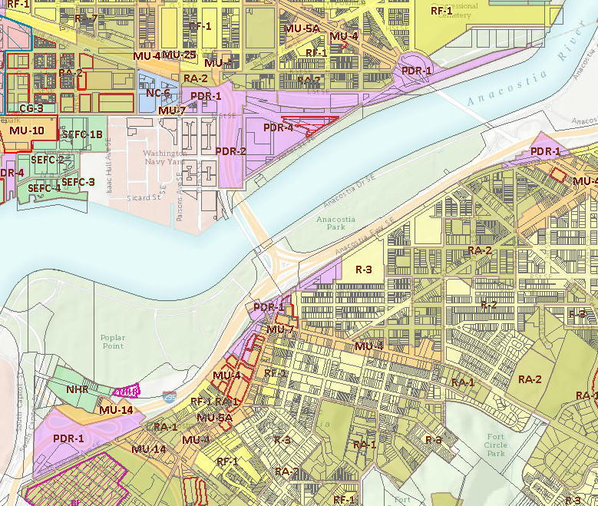
ZC Cases
Map Amendments & PUDs

Slide 8
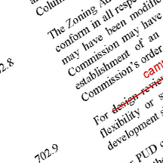
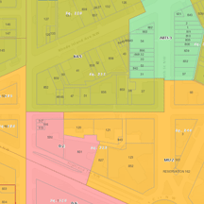
TYPES OF ZC CASES
Text Amendment
Petition to change the text of the Zoning Regulations
Follows rulemaking procedures
Map Amendment:
Application/Petition to change the Zone District applied to a property; can include adding a new Zone District to an area.
Could be a rulemaking or a contested case, depending on the circumstance

Slide 9
TYPES OF ZC CASES
Map Amendments:
In all cases, the Zoning Commission shall find that the amendment is not inconsistent with the Comprehensive Plan and with other adopted public policies and active programs related to the subject site
Rulemaking
Quasi-legislative
Contested Case
Quasi-judicial function
Applicant has the burden of proof
Broader policy issues
Specific parties
Notice & comment procedures

Slide 10
TYPES OF ZC CASES
Planned Unit Developments (PUDs):
Review process for larger developments to ensure high quality development and public benefits
In exchange for zoning flexibility, the Applicant must provide benefits and amenities to the community as part of the project
Public benefit categories can be found in Subtitle X § 305 and include categories like:
Affordable housing
Employment and training opportunities
Mass transit improvements
Superior urban design and architecture
Environmental and sustainable benefits

Slide 11
TYPES OF ZC CASES
Planned Unit Developments (PUDs):
The Zoning Commission shall find that the proposed development:
Is not inconsistent with the Comprehensive Plan (or other adopted public policies and active programs)
Does not result in unacceptable project impacts on the surrounding area (must be either favorable, capable of being mitigated, or acceptable given the quality of public benefits in the project)
Includes specific public benefits and project amenities of the proposed development that are not inconsistent with the Comprehensive Plan

Slide 12
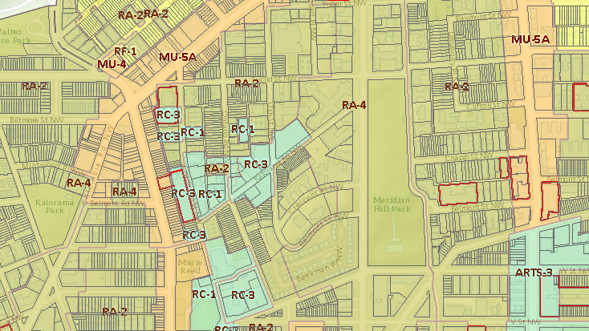
Participation in Zoning Cases

Slide 13
RESEARCH A CASE
Interactive Zoning Information System (IZIS): https://dcoz.dc.gov/service/interactive-zoning-information-system

Slide 14
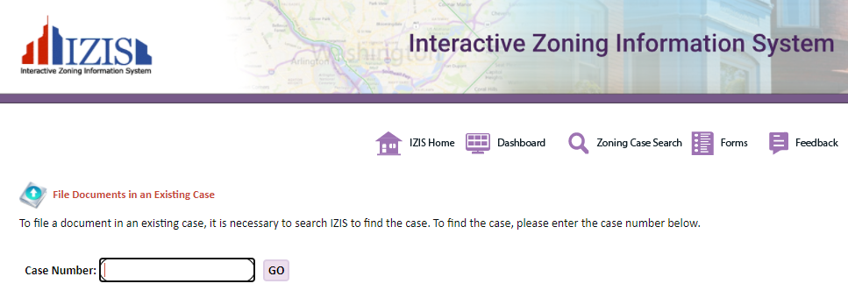
COMMENT ON A CASE
Written comments can be:
Uploaded to the case record via IZIS: https://app.dcoz.dc.gov/Login.aspx
Emailed to zcsubmissions@dc.gov
Deadline: 24 hours before the start of the hearing on the case

Slide 15
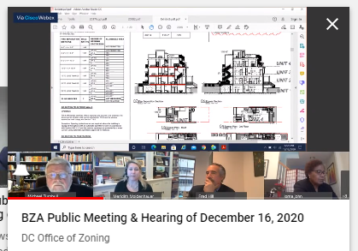
PARTICIPATE IN A HEARING
For a contested case, the ZC and BZA take testimony from the Applicant, OP, and any parties to the case
Affected ANC(s) are parties and may present testimony and cross-examine other parties
In all cases, the public may provide testimony (3 minutes for individuals)
NOTE: When the ZC or BZA hold a meeting, it is to deliberate on and decide cases. No public testimony is taken at that time.

Slide 16
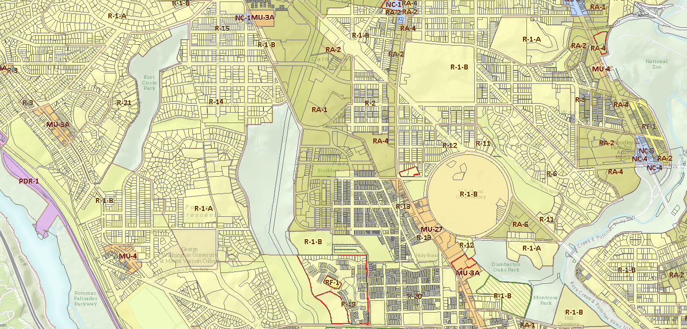
VIRTUAL HEARINGS
HOW TO WATCH OR LISTEN
- Watch live via Webex, YouTube; listen via phone
- Available next day on DCOZ Website and on YouTube
HOW TO SIGN UP TO PARTICIPATE
Fill out form on DCOZ website
https://dcoz.dc.gov/service/sign-testify
Sign up with DCOZ staff
ZC: 202-727-0340
BZA: 202-727-5471

Slide 17
QUESTIONS?
Please feel free to contact us:
Allison Myers, General Counsel
allison.myers@dc.gov / 202-727-2806
Sharon Schellin, Secretary to the Zoning Commission
sharon.schellin@dc.gov / 202-727-0340
Clifford Moy, Secretary to the Board of Zoning Adjustment
clifford.moy@dc.gov / 202-727-0348

